Slide 1
Chiselled Ubuntu containers
Valentin Viennot – Canonical
September 14, 2022

Slide 2
How and why (Ubuntu) distroless?
Provenance + Security concerns with Open Source Software
Containerisation is not enough to secure an application
Abstracting dependencies also abstracts vulnerabilities
Layering mechanism ⇒ many containers based on the same content
Keeping content up-to-date with containers isn’t straightforward

Slide 3

How and why (Ubuntu) distroless?

Slide 4
How and why (Ubuntu) distroless?
There’s a correlation between size of the image and number of CVEs

Slide 5
How and why (Ubuntu) distroless?
There’s a correlation between size of the image and number of CVEs
Reducing the size helps but isn’t enough
Content provenance matters!
And Developer Experience + ecosystem + support also matters
reducing the size benefits both small and at-scale environments
(reduces storage and memory resources consumption)

Slide 6
How and why (Ubuntu) distroless?
Containers didn’t kill Linux distributions….
… but …
… there’s a security and resources consumption challenge to solve

Slide 7
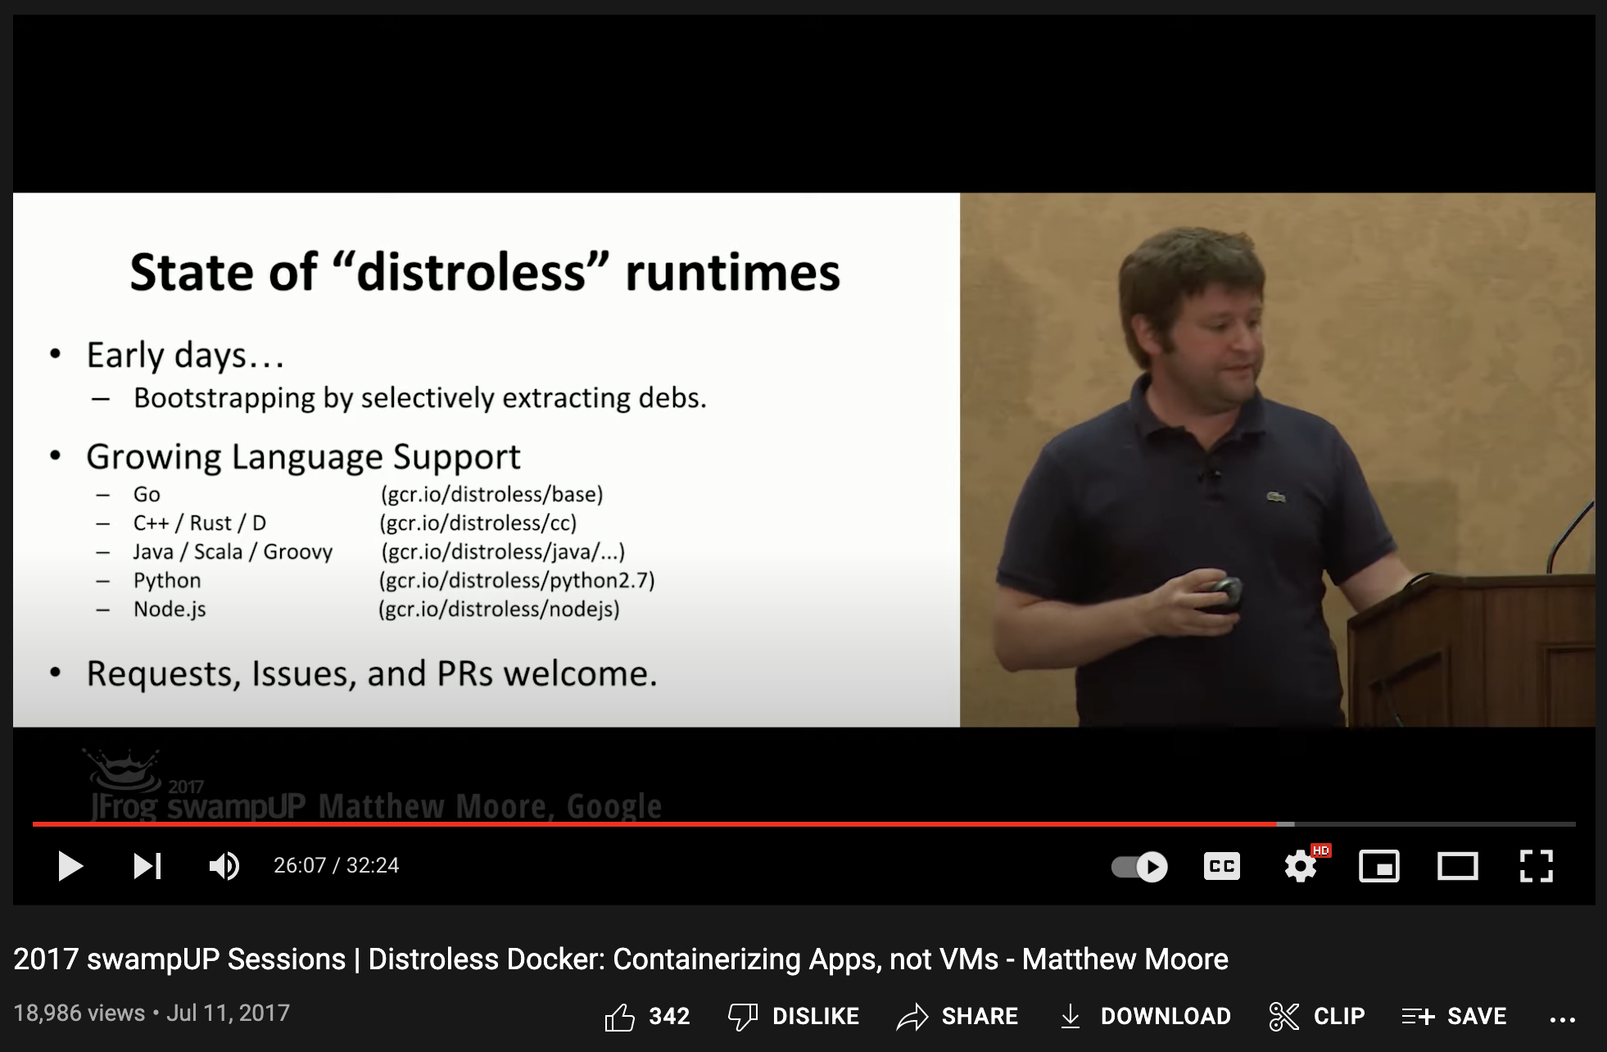
How and why (Ubuntu) distroless?
Google Distroless (https://youtu.be/lviLZFciDv4)
(+)
No package manager
No shell
About 20MB
Useful as/for runtime images
(-)
Complex to use
Complex to build
No support
Built with Bazel

Slide 8
How and why (Ubuntu) distroless?
Google Distroless (https://youtu.be/lviLZFciDv4)
(+)
No package manager
No shell
About 20MB
Useful as/for runtime images
(-)
Complex to use
Complex to build
No support
Built with Bazel

Slide 9
How and why (Ubuntu) distroless?
Could we have the advantages of a Linux distribution
… without the overhead?

Slide 10
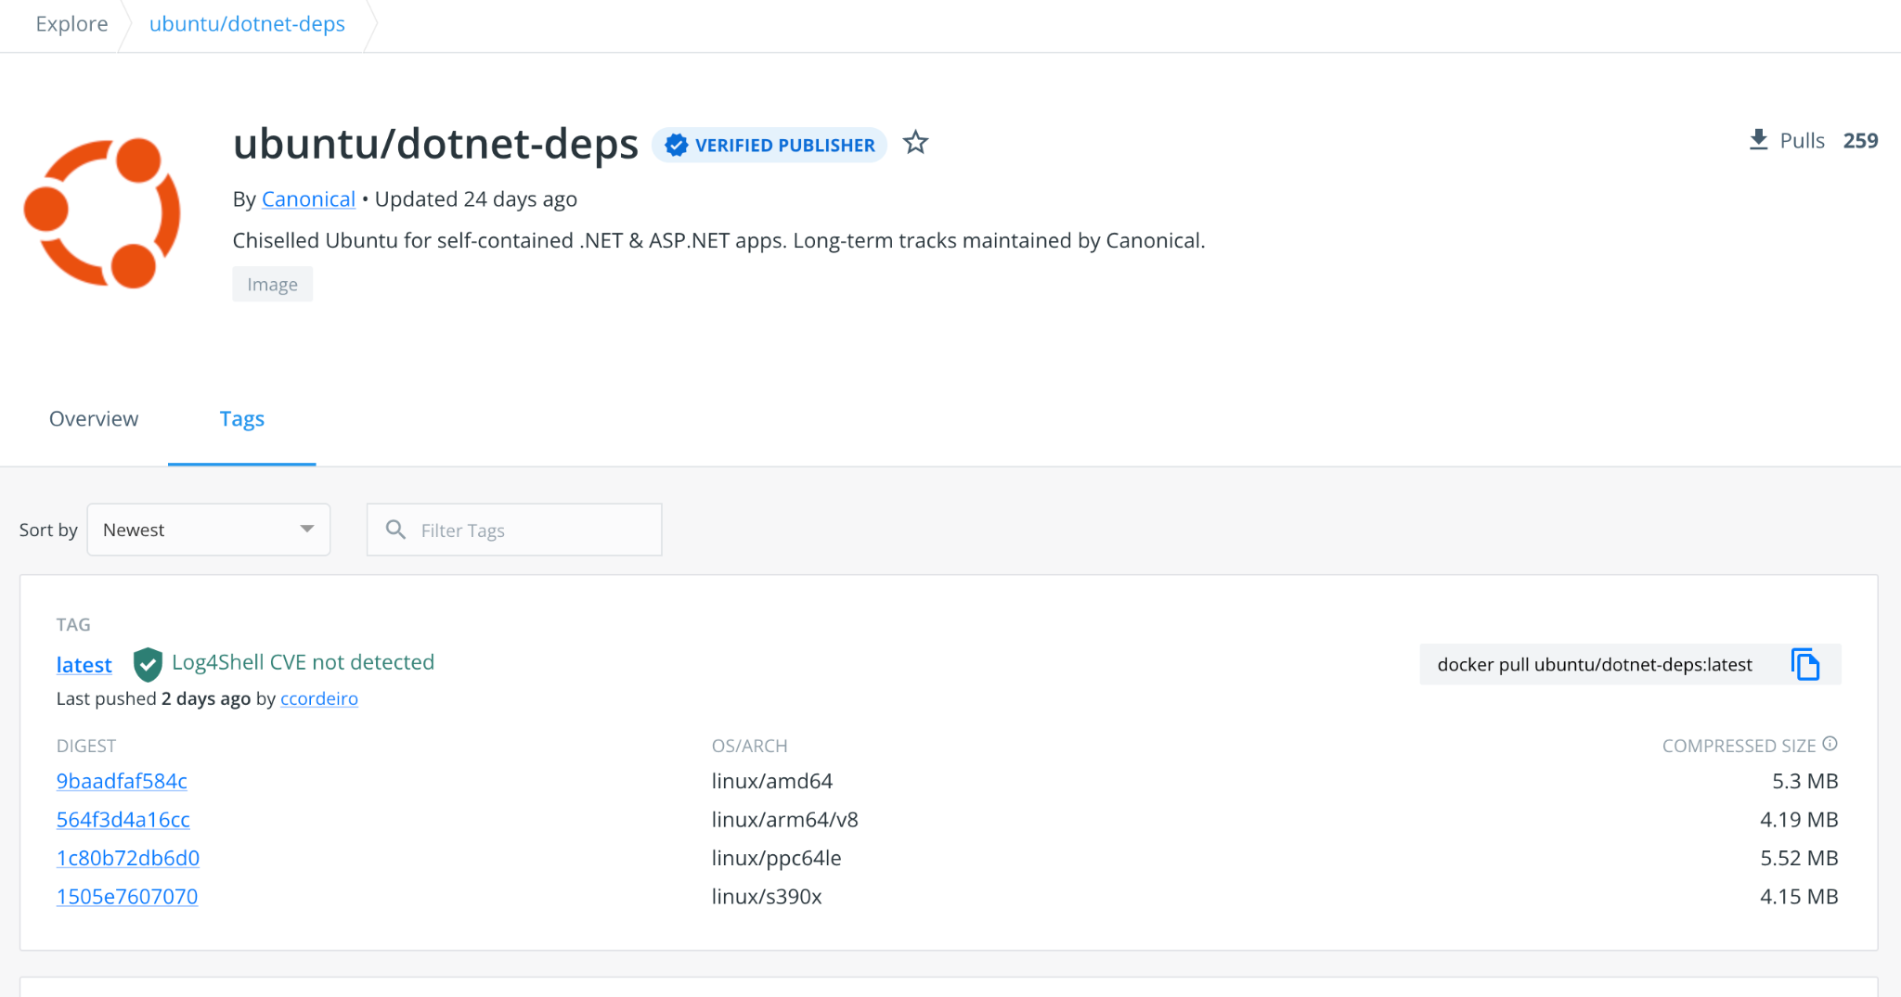
How and why (Ubuntu) distroless?
Chiselled Ubuntu containers for <insert-app-or-runtime>

Slide 11
Chiselled Ubuntu containers?
<12MB for an “Ubuntu Distroless base”
No package manager (avoid whole class of attacks)
No shell (avoid whole class of attacks)
Based on known and supported Ubuntu packages
Compatible developer experience from host/server/container/chiselled
  from (70MB, build)
  FROM ubuntu:22.04
  to (13MB, run)
  FROM ubuntu/dotnet-deps:22.04
Debian package B
B_slice1
B_slice2
A_slice1
A_slice2
A_slice3
Debian package A

Slide 12
Questions / Comments

